Slide 1
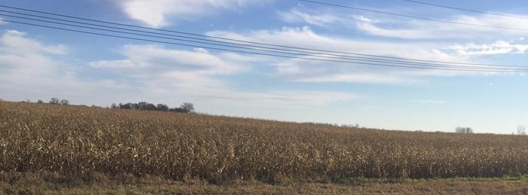
Mowing and Haying in the Right of Way
Public Engagement Process
Cori Calhoun | Division Business Manager
Jed Falgren | PE - ADE Maintenance (D7)
Notes:
You may have seen the presentations that Nancy Daubenberger that really talked about the content and focus o the PE
Today I’m going to focus on how we approached this with the end in mind so we could close the loop.

Slide 2
Public Engagement Process
Evaluated topic for engagement scope & to identify customers
Determined methodology to use (3rd party facilitator)
Created a stakeholder group – external and internal
  Focused on education, listening, documenting, and neutrality
Held public listening sessions
Provided flexible options for open dialogue (and responded!)
  Website
  Mail
  Word of mouth
  In person
Communicated along the way
Notes:
Cori - Set the -
Determined methodology: Really wanted a robust, fair, and neutral process
Start with education
Seek mutual understanding
Share perspectives and interests
Understanding does not mean agreement
Invite the public to share – formally and informally
Use active listening
Manage expectations
What will happen with this feedback?
We developed the process with the end in mind, made corrections along the way, and even after our best efforts, there are things we can learn and apply differently in the future.

Slide 3
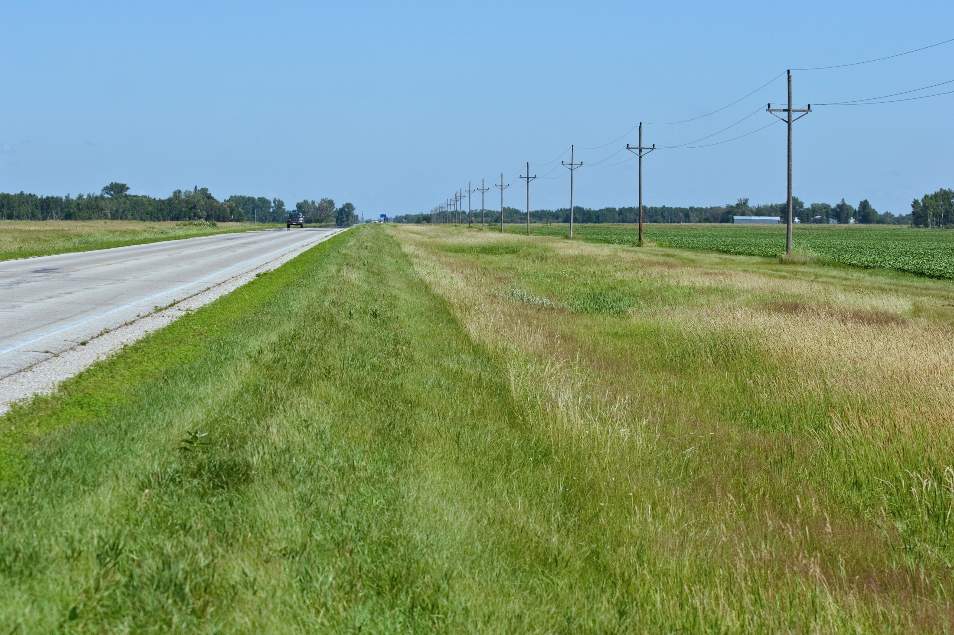
Demands on MnDOT’s Roadsides
Fiber Optic Lines
Blowing Snow Control
Buffer Homes from Road
Protected Species Habitat
Electric Lines
Invasive Species Control
Snow Storage
Slope Stability
Survey Monuments
Road Structure Stability
Safety
Business Visibility
Erosion Control
Solar Arrays (future)
Ground Nesting Bird Habitat
Water Conveyance
MnDOT’s Technologies
Pollinator Habitat
Aesthetics
Water Infiltration
Hay
Filter Runoff
Maintain Cultural Resources
Water/Sewer Pipes
Clean Water
Gas Pipelines
3
Notes:
Cori –
As mentioned earlier, everything started with education. MnDOT shared what they do with the stakeholders and with the public during the listening sessions. At the same time, they managed expectations – first by sharing our priority. Then we shared all of the other considerations we need to keep in mind as we make decisions. We also went into the laws, the regulations, and provided statistics to further illustrate the complexity of the topic.

Slide 4
Closed the Loop in Multiple Ways
Externally
Responded to all online submissions through email
Summary of public input posted on the MnDOT website
  Minutes, input, feedback
Recommendations provided to legislature based upon stakeholder meetings (representing compromise)
  Also issued press release & shared with stakeholders
Notes:
Cori or Jed –
Speak to providing a summary on the website. In hindsight, if we had planned on that, we could have asked for contact info

Slide 5
Closed the Loop in Multiple Ways
Internally
Connected back to those most impacted by the process and decisions and throughout process
  Permits group and Maintenance Business Management Team
Presented process to Public Engagement groups
Presented the input/recommendations
  Internal evaluation summarized key aspects of “process” (summary in packet)
Notes:
Jed
Speak to providing a summary on the website. In hindsight, if we had planned on that, we could have asked for contact info

Slide 6
Closing the Loop – Stakeholder group
Plan how to close the loop at the beginning:
  Plant the seeds early
    Helps develop and manage expectations
  Close small loops along the way…
    Identifies issues early so they can be addressed quickly
    Brings everyone along
  …and at the end
    Shared recommendations at last meeting; revised; shared via email for final feedback
    Circled back with final recommendation document for their records
    Press release to the public
Notes:
Jed

Slide 7
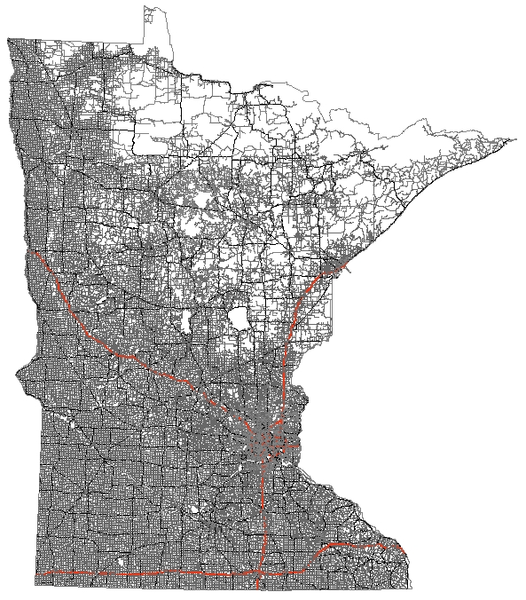
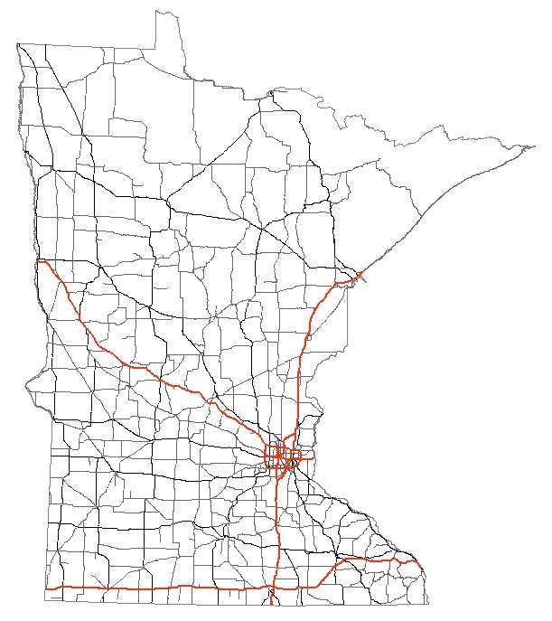
MnDOT’s Area of Responsibility
Notes:
Jed - We included visuals of the roadways in MN and isolated just those that we were discussing. This helped frame the discussion and narrow it down to the State Highway ROW.
First image:
MnDOT manages Interstate, US and MN State Highways
We own approximately 12,000 miles of road in MN which equates to approximately 175,000 acres of green space (roadside, medians, etc)
Second Image:
When we add in the additional city, county, township roads, you can see that MnDOT manages approximately 10% of the roads in MN.

Slide 8
Value of Closing the Loop
-Lessons Learned
Evaluate methods along the way, make adjustments, and document
  Minute approvals delayed posting of minutes externally
    Format of approval process was adjusted mid-way through
  Add the address to the paper feedback form handed out
    Missed opportunities by adding it later
  Listening sessions could have gathered contact information
    Would need to be vetted for data practices before enacting
Notes:
Cori –
We did add the address form to the bottom of the form and to the last powerpoint slide after we realized what we had missed. By then we had already had a couple of listening sessions and so we missed an opportunity for feedback.
We intentionally did not ask for contact information because we thought it would hinder people signing up to speak and because it was private data. In hindsight, we could have explored making it optional with the intent and purpose of allowing us to share the final version.

Slide 9
Closing the Loop Group Activity
Handout/Qns
Group discussion
Report Back
SCENARIOS

Slide 10
Barriers/Issues (set-1)
Contacting Public / Public Access:
  Public not asked how they want to engage
    Ask for preferences early on
  Contact information not collected
    Plan for collection when designing
  Privacy, confidentiality & access to record
    Evaluate need for signed consent, etc.
    Record with awareness of what is public record
Timing:
  Large gap between efforts and decisions
    Give timing indication upfront (establish and manage)
    Can be iterative (heard, recommended, etc.)
  Input can make schedules change/longer
    Communicate when projects have been redirected
    Keep public informed during delays

Slide 11
Barriers/Issues (set-2)
Limited role of PE staff:
  Can summarize and recommend; may not know what was done
    Need to get decision-maker commitment upfront / ongoing
Sensitive topics:
  Contentious issues may cause reluctance to report back
    Need to report back regardless and accept risks that go with dissatisfaction
  Decision can look biased
    Show how process was fair, robust and honest (document)
    Communicate on process and results

Slide 12
Thank You

